Slide 1



Smart India Hackathon 2025
Problem Statement ID - SIH25031
Problem Statement Title - Crowdsourced Civic lssue Reporting and Resolution System
Theme - Clean & Green Technology PS Category - Software
Team ID - Pending Allocation Team Name - Team VegaPunk
1

Slide 2


CivEcho
Team Vegapunk
Mobile/Web platform "CivEcho" enables one-tap photo reporting of civic issues.
Auto-GPS tags locations; AI auto-detects issues and prioritizes them. AI drafts descriptions, user verifies with one tap, issue is routed to
30%
resolved
concerned departments via admin dashboard.
70%
Detailed Solution:
Capture & Tag - User snaps photo; auto-GPS tags location for
accurate mapping.
AI Analysis & Verify - ML Kit detects issue (e.g., pothole); Gemini drafts description and priority, reducing report time by 70%;
user confirms with one-tap to ensure accuracy.
Track & Resolve - Citizens can track their reports, and are kept updated using notifications with real-time progress reports by the admin.
Transparency - Dashboard displays submitted vs. resolved issues and resolution times, visible to all, promoting accountability.
Admin Dashboard - Web portal offers filtering, task assignment, and department routing, enhancing municipal efficiency.
unreported
Smart issue resolution:
Fast reporting: Mobile app
with photo uploads and geotagging Efficiency: AI/NLP categories issues; cutting resolution time by 70%
Transparency: Real-time tracking via dashboards
Innovation and Uniqueness of Solution
AI powered Categorization: NLP and computer vision auto detect and classify issue, reducing manual efforts. Smart Priority with AI: The system uses AI to decide which issue need fixing first
Photo based detection: AI looks at photos you upload
and identify the problem automatically
predictive Analysis: Instead of just reports, use trend
prediction
2

Slide 3

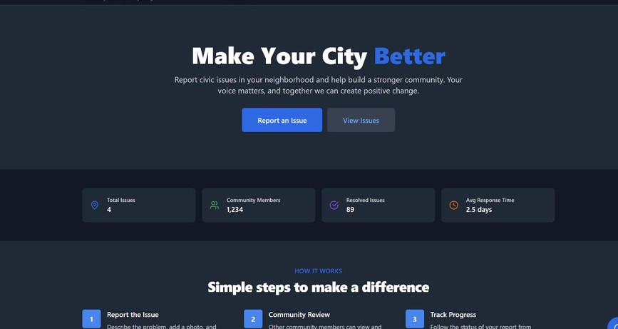
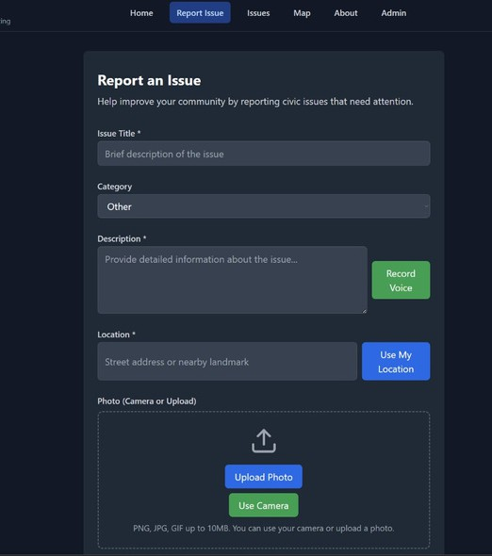
TECHNICAL APPROACH
Team Vegapunk
Technologies:
React Native- mobile app, cross-platform UI Node.js + Express - backend server, API endpoints
Firebase - Firestore for DB, Storage for photos, Auth for users
Google ML Kit - on-device AI issue detection Gemini API - cloud-based description generation Google Maps API - real-time mapping with GPS
Photo Capture
AI Analysis
Save to Firebase
Verification by User
Status updates
Admin Dashboard

Slide 4

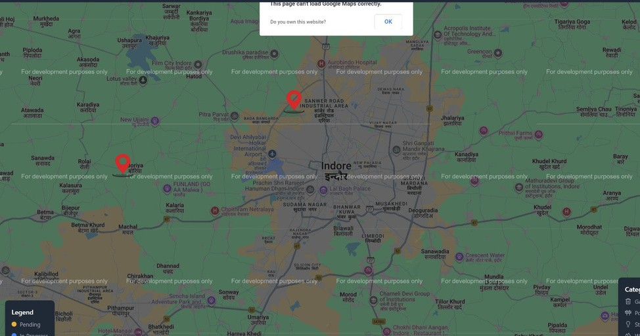
FEASIBILITY AND VIABILITY
Team Vegapunk
Analysis of the feasibility of the idea:
Cross-platform design (React Native) suits diverse devices globally.
Free-tier Firebase and Google APIs scale for cities like Indore (3M+) to megacities.
Simple UI ensures adoption by all age groups and tech levels.
Potential challenges and risks:
User adoption may lag due to awareness or trust in AI accuracy.
Municipal resistance to new workflows or data overload.
Network issues in rural areas could disrupt real-time updates.
Strategies for overcoming these challenges: Launch awareness campaigns with Indore pilot success stories.
Train municipal staff and offer customizable dashboards.
Enable offline mode with queued uploads for rural resilience
3

Slide 5







IMPACT & BENIFIT
Team Vegapunk
Citizen :
Easy reporting via mobile
Real-time issue tracking builds trust
Social
Econimics
Environmental
50
Government :
40
Faster Resolution
Analytics dashboards for Data-driven Decisions
30
20
Communities :
Safe and Clean cities through faster fixes Stronger civic pride and collaboration
10
0
Social
Econimics
Environmental
5

Slide 6
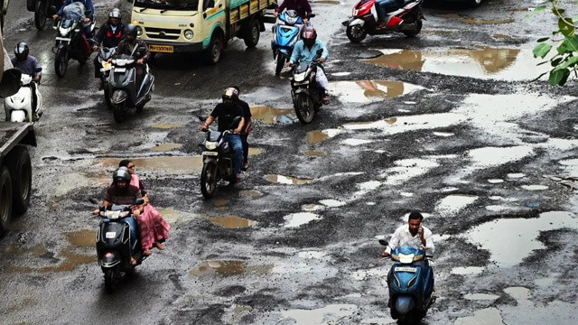
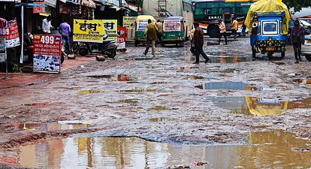
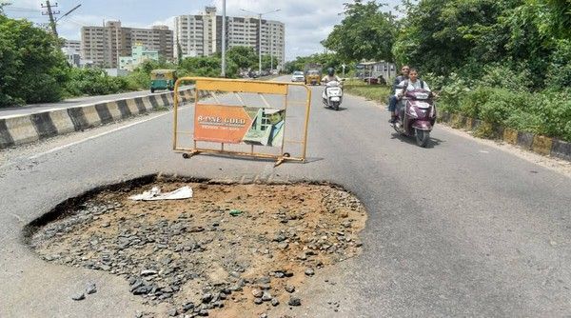
References
Team Vegapunk
Indore civic issues (potholes, flooding): X posts + Swachh Survekshan 2025 reports. Civic app models: SeeClickFix (USA), FixMyStreet (UK) – studied workflows.
Tech guides: Firebase Docs, Google ML Kit Tutorials, Gemini API Quickstart. Local data: Indore Municipal Corporation stats (public domain, 2025).
Mumbai
Indore
Banglore
Sahil Kumar Bhushan Dhake
Diya Tomar Deepak Yadav
Samiksha Kutre Al aqmar Haamid

